Slide 1
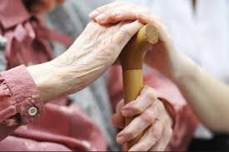
Geriatrics nutrition (HEA-302)
Nasreen Afroze
Associate Professor
Eden Mohila college

Slide 3
Definition

Slide 4
Classification of old age
The older adult population can be divided into three life-stage subgroups:
The young- Old (approximately 65–74),
The middle-old (ages 75–84),
The old-old (over age 85).
Today's young-old age group is generally happier, healthier, and financially better off than the young-old of previous generations.

Slide 6
Problems faced in old age
Emotional problems (depression)
Anorexia- lack or loss of appetite for food
anorexia tardive-the characteristic symptom of a disease, such as a lesion, may occur a long period after exposure. ... These disorders arise from the long-term usage of anti-psychotic medication.
abuse of elders -social problems
Late-life paranoia - a mental condition characterized by delusions of persecution, unwarranted jealousy, or exaggerated self-importance, typically worked into an organized system. It may be an aspect of chronic personality disorder,
Swallowing disorders (dysphagia) Oral factors

Slide 7
Problems faced in old age
No money (poverty)
Wandering - travelling aimlessly from place to place.
Dementia
Hyperthyroidism, hyperparathyroidism,
Hypoadrenalism –These symptoms are Extreme fatigue, Weight loss and decreased appetite , Darkening of your skin(hyperpigmentation),Low blood pressure, even fainting,, Salt craving ( a salt craving can be tied to a medical condition or a sodium deficiency.)Low blood sugar (hypoglycemia),
Enteric problems (malabsorption)-Nausea, diarrhea or vomiting (gastrointestinal symptoms),abdominal pain.
Eating problems (inability to self-feed)

Slide 18
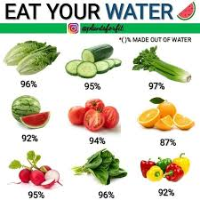
Water Intake
Total Water (Liters/Day)
Male:3.7,
Female: 2.7
This includes all water contained in food, beverages and drinking water.

Slide 21
Thanks all of You

