Slide 1
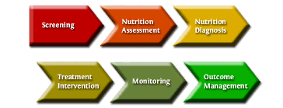
Chapter 6. Method of Nutritional Management- development of nutritional care plan, evaluation of nutritional care plan. HEA-302
Nasreen Afroze
Associate Professor
Eden Mohila college

Slide 2
What is it
The Nutrition Care Plan (NCP) is a systematic approach to providing high quality nutrition care. The NCP consists of four distinct, interrelated steps:
Nutrition Assessment: The RDN (Registered Dietitian Nutritionist. )collects and documents information such as food or nutrition-related history; biochemical data, medical tests and procedures; anthropometric measurements, nutrition-focused physical findings and client history.
Nutrition Diagnosis: Data collected during the nutrition assessment guides the RDN in selection of the appropriate nutrition diagnosis (i.e., naming the specific problem).
Nutrition Intervention: The RDN then selects the nutrition intervention that will be directed to the root cause (or etiology) of the nutrition problem and aimed at alleviating the signs and symptoms of the diagnosis.
Nutrition Monitoring/Evaluation: The final step of the process is monitoring and evaluation, which the RDN uses to determine if the client has achieved, or is making progress toward, the planned goals.
This is the extended approch of Triple A, 1.Assessment 2. anlysis 3. Acition (3,4)

Slide 4
